Slide 1
Week 7
Advanced Image Processing
Face Detection
Notes:
Things to improve:
Confusion about copying into/out of OS-provided buffers

Slide 2
Face Detection
This is a common problem, many solutions exist
Some faster, some slower, some more accurate, etc….
We’re going to look at two:
Eigenfaces
Viola-Jones
We’re only going to implement the latter
The former is just to think about techniques for signal processing!

Slide 3
Eigenfaces
Eigenfaces relies on the concept of principal component analysis (PCA)
Takes a lot of data in, finds common components, or patterns
Often viewed in terms of “trials”
E.g. “Across all trials”, what remains constant?
Often used in machine learning
Is able to look at a dataset and discern simple patterns

Slide 4
PCA Theory
Singular Value Decomposition on a matrix X
That’s the same thing as Eigenvalue Decomposition on the matrix X^{T}X
Decomposes X into U, S, V such that:
S is a diagonal matrix of singular values
These control the weighting of the singular vectors
U, V are the left and right singular vector matrices
The columns of U and the rows of V represent bases for the signal space

Slide 5
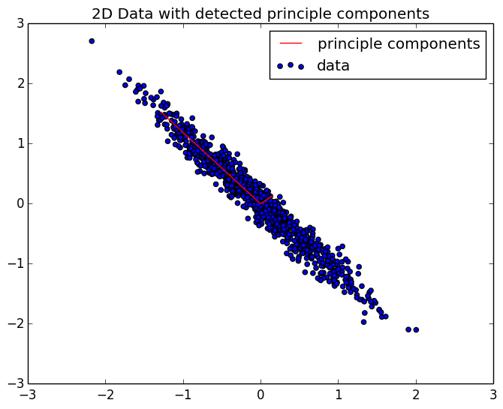
PCA Theory
PCA will transform X onto a specific basis
The basis are those which “best describe” X, in an energetic sense

Slide 6
PCA Live Demo
See final result here

Slide 7
Eigenfaces
We use PCA to learn the overall structure of a face
The overall structure of a face will become a single principle component
We represent an image of a face as an N-D vector
We construct matrix X with multiple images of faces
The components of the images that are consistent are the PC’s

Slide 8
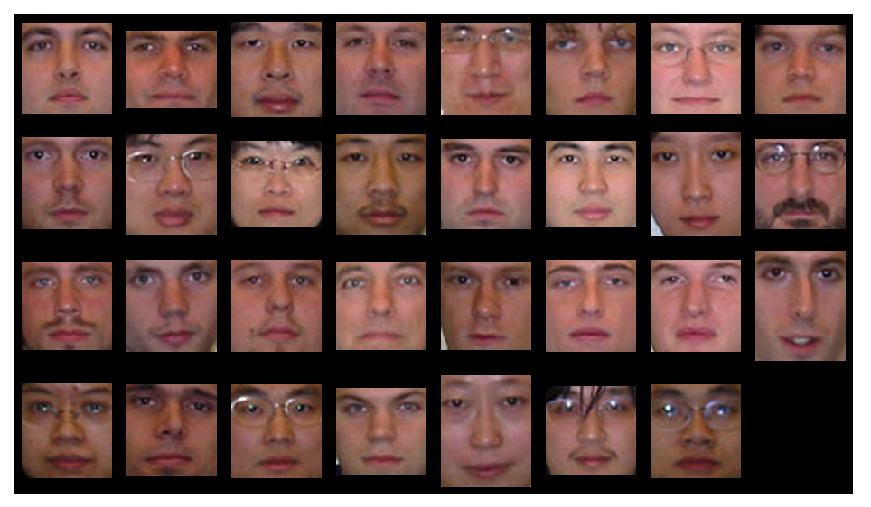
Eigenfaces

Slide 9
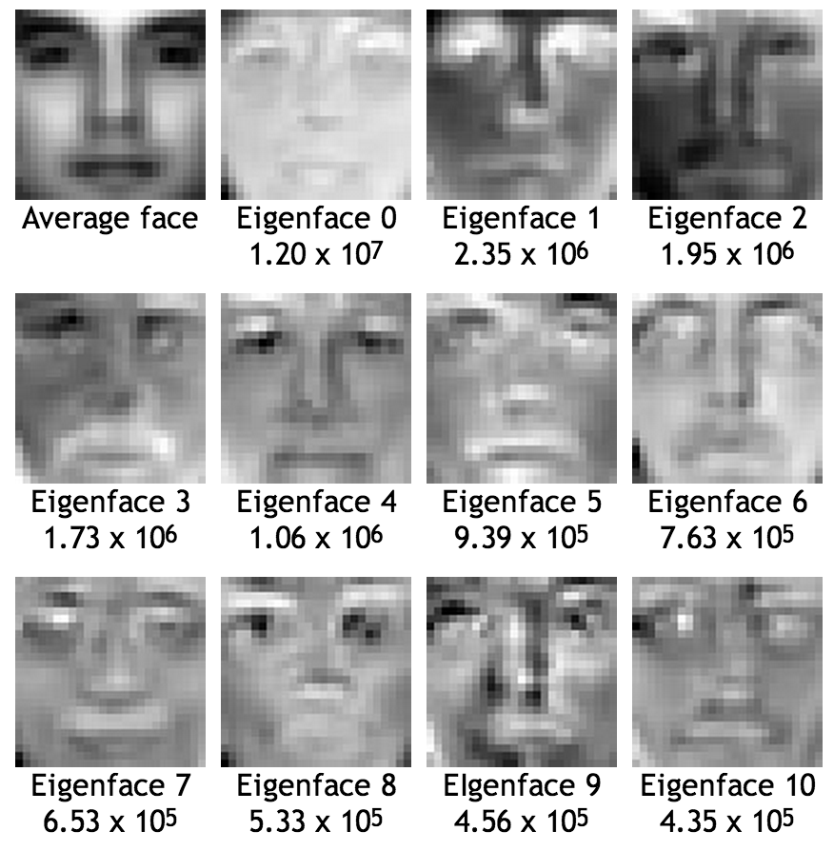
Eigenfaces

Slide 10
Eigenfaces
To detect a face, we decompose a test image
Using the same eigenvectors (or “eigenfaces”) as found earlier in training
If the eigenvalues of this image are close enough to those we found in training on real faces, it’s a face
Each eigenvalue represents the weight of that eigenface
Weight == contribution of that eigenface to the overall image
We do this decomposition for every possible subimage
Classifying each as a face or as not a face

Slide 11
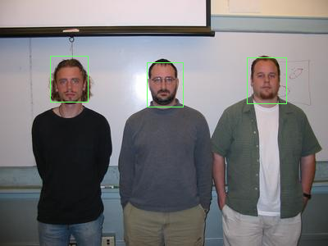
Eigenfaces

Slide 12
Viola-Jones
Viola-Jones is an object detection framework
Not just faces, but commonly used for such
Uses a cascade of “weak classifiers”
Each classifier is very simple, uses a single computationally easy feature
The result of all classifiers is combined into a single decision
The classifiers use a “Haar-like” feature
Basically, black and white rectangles

Slide 13
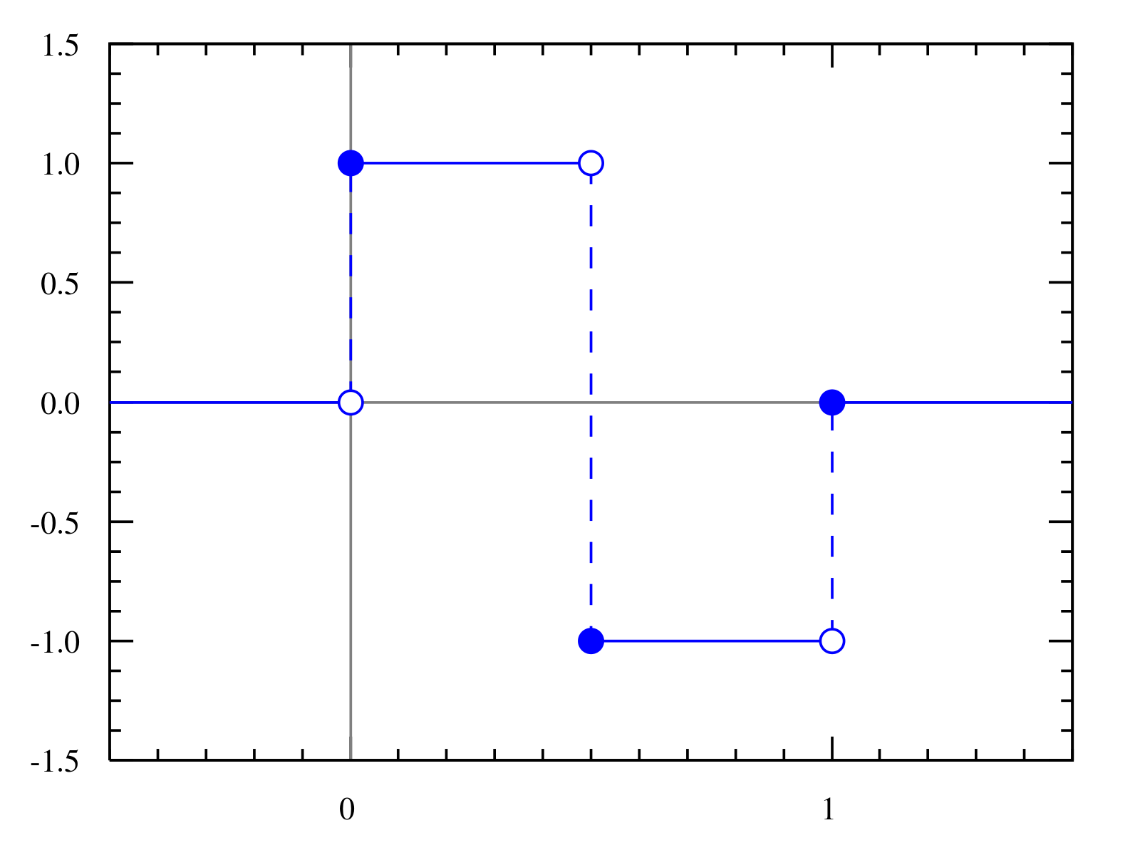
Features
The Haar wavelet

Slide 14
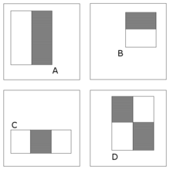
Features
Two-dimensional, Haar-like features

Slide 15
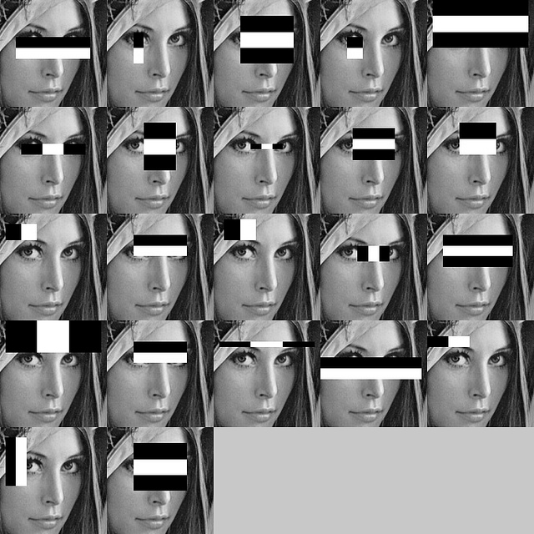
Features
These features are then correlated with our signal

Slide 16
Classifier Cascade
Using the output of one feature, make a decision
This will not be very accurate!
Cascade these classifiers for the final decision
Classifier 1
Classifier 2
Classifier N
Not a face
Face!

Slide 17
Classifier Cascade
All the intelligence is in the ordering of classifiers
This “ordering of classifiers” is essentially our model
This is built offline, using lots of training data
The most reliable features are used first, the lesser ones last
Use Machine Learning to create this model!
Most implementations use something called AdaBoost
This chooses the best features, and orders them for our model

Slide 18
Learning the Cascade
The number of possible features is enormous
Remember, our features look across permutations of scale as well!
For a 24x24 pixel window, there are 162,332 features
This is just too many to use all at once
AdaBoost will pick the ones that are most useful
“Useful” – Highest accuracy
Iteratively chooses features that complement existing weaknesses

Slide 19
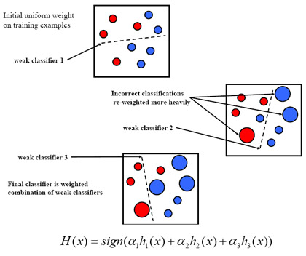
Learning the Cascade

Slide 20
Learning the Cascade
AdaBoost isn’t something you write yourself
In fact, oftentimes you don’t even need to use it
Preexisting models are available on the internet for our use
The OpenCV project has pre-learned cascades
Not only for faces, but an array of objects
Stored as .xml files describing the cascade of classifiers
Also contains methods for learning your own cascades given data

Slide 21
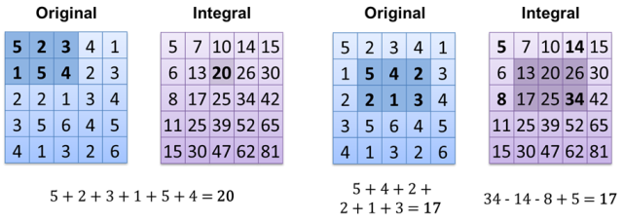
Using the Cascades
Evaluating all features on all subimages is slow
Way, way, way, too slow, even for desktop computers
However, there is a cheat we can use
We can calculate the integral image

Slide 22
Using the Cascade
This allows a single feature to be calculated quickly
Really, really, quickly! Four additions, regardless of the size of the feature!
Almost all the work is then in doing the integral
A small price to pay!
This is what allows this kind of detection to be done in real-time on a desktop computer
We can get close on our phones, we need to run at a low resolution

Slide 23
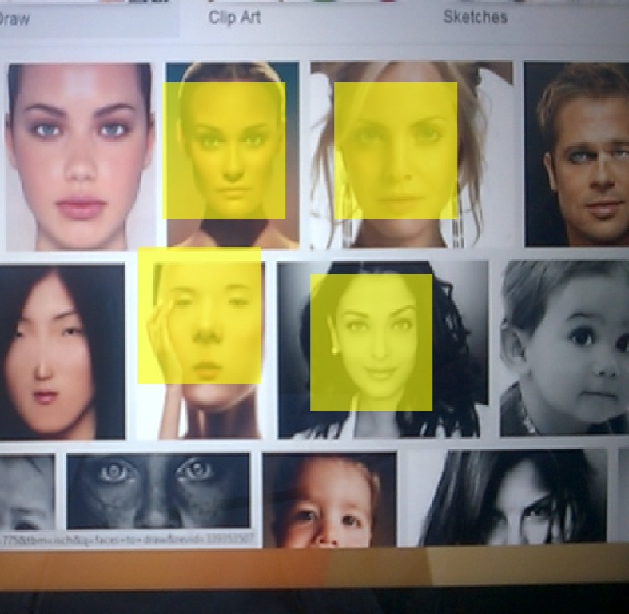
“Live” demo
Again, this doesn’t work too well on the emulator
So instead, here’s a screenshot from the example App!

Slide 24
Bonus Slide: CV Dazzle
I came across this while researching Viola-Jones
CV Dazzle, hairstyles and makeup designed to counteract facial recognition algorithms
Purposefully disrupts the features discussed today
Breaks up the “rectangular” features
Causes the weak classifiers to fail miserably

